Slide 1


Slide 2
CONTENTS
Introduction
Existing System
Limitations of existing system
Proposed System
Hardware and software requirements
Implementation roadmap
Conclusion
References

Slide 3


INTRODUCTION
Problem Statement:
Providing related content out of relevant and irrelevant collection of items to users of online service providers.
Restaurant recommender system aims to recommend restaurants to users based on user-restaurant ratings, reviews, price and location.

Slide 4


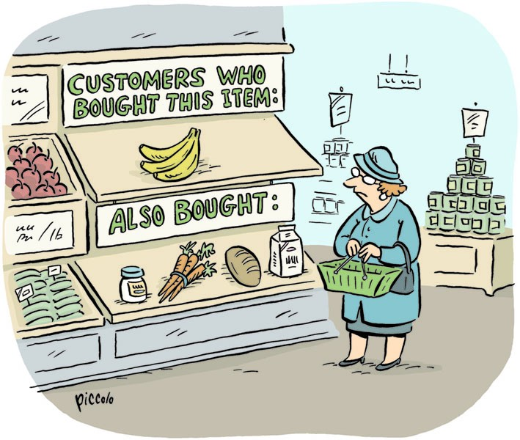
So, what is a recommender system?
A recommender system is an information filtering system that seeks to predict the “rating” or “preference” that a user would give an item.
Recommender systems are used in a variety of areas including movies, music, news, books, research articles, social tags and products in general.
The best use-case of a recommender system is Netflix. More than 80% of the TV shows that people watch on Netflix are discovered through the platform’s recommendation system.

Slide 5
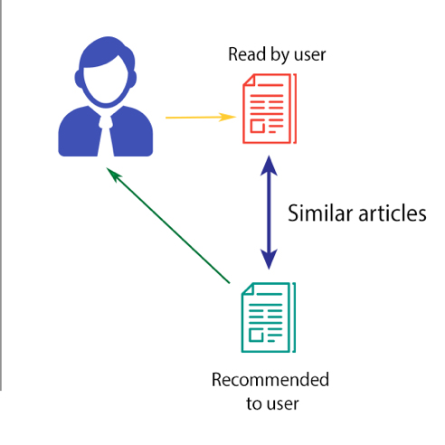
And types….?
Recommender systems typically produce a list of recommendations in 2 ways:
Content-based filtering
Collaborative filtering
Content-based filtering recommends items based on comparison between the content of the items and user profile. To create a user profile, the system mainly focuses on 2 types of information:
A model of the user’s preference.
A history of user’s interaction with the recommender system.

Slide 6
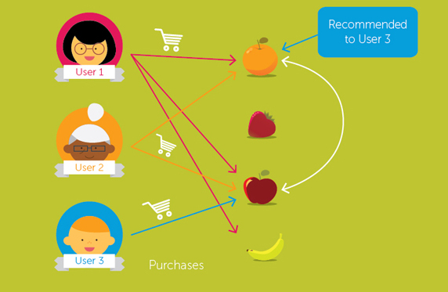
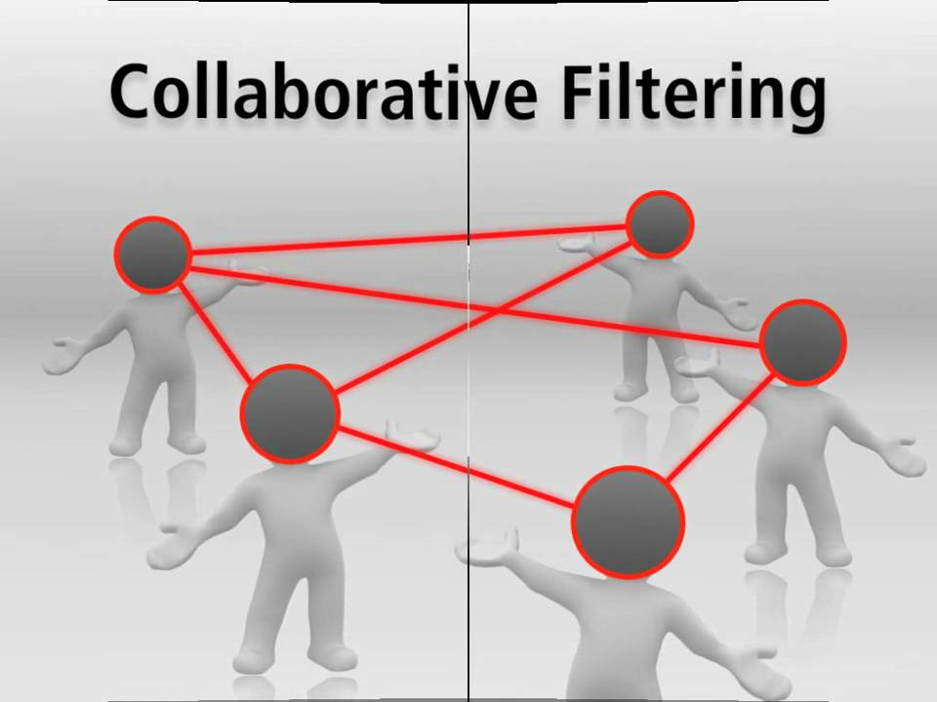
Collaborative-filtering is based on collecting and analysing large amount of information on various user’s behaviours, activities or preferences, and predicting what users will like based on their similarity to other users.
This approach is capable of accurately recommending complex items such as movies, without requiring an understanding of the item itself.
Collaborative-filtering is based on the assumption that people who agreed in the past will agree in the future, and that they will like similar kinds of items as they liked in the past.

Slide 7
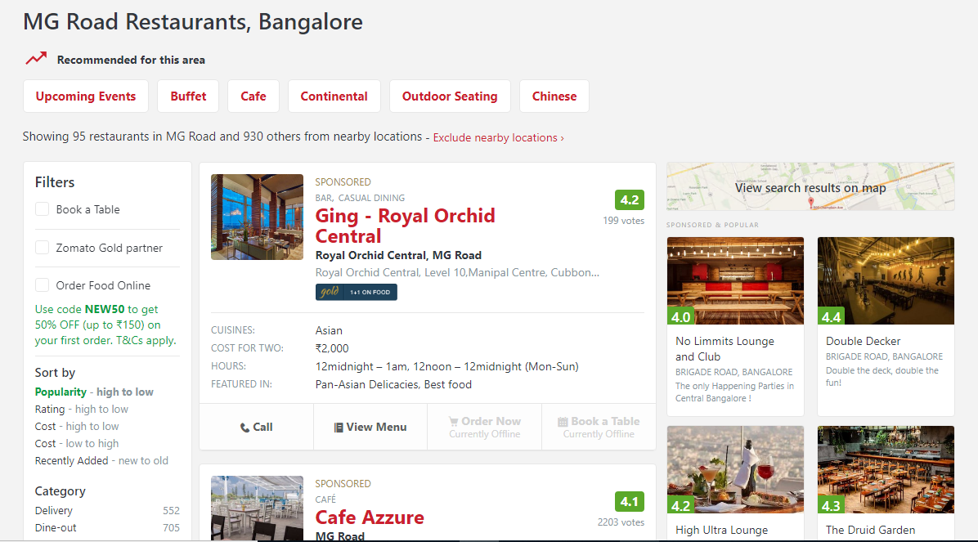
EXISTING SYSTEM

Slide 8
LIMITATIONS
Does not take user interest into account
Neglects the influence of different rating standards
Less accountable result

Slide 9
PROPOSED SYSTEM
A restaurant recommender system which uses collaborative filtering to provide recommendations based on ratings provided by other similar users and the browsing history of the current user.
Advantages
Higher algorithm performance
More accurate results

Slide 10
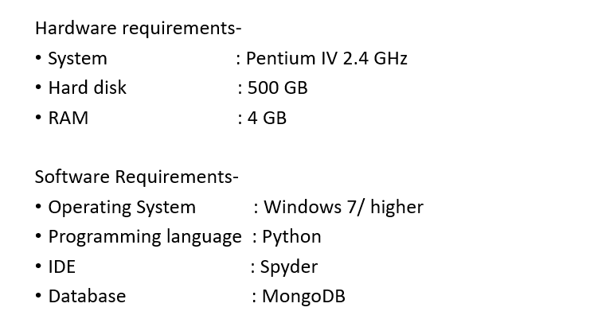
Software and Hardware Requirements

Slide 11
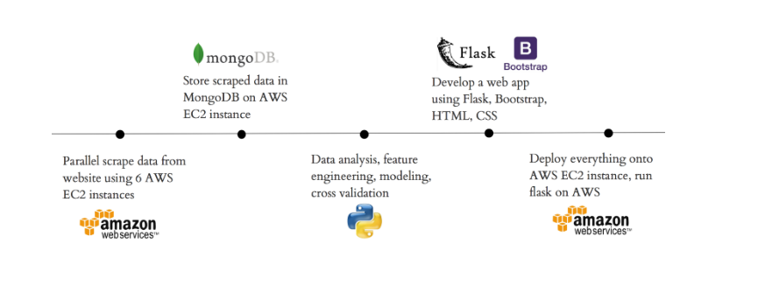
Implementation Roadmap

Slide 12
CONCLUSION
Recommendation systems provide content for us by taking what other people recommend as well as our selections into account.
Collaborative-filtering is a widely used solution for this problem which we make use of in our project

Slide 13
REFERENCES
https://www.sciencedirect.com/science/article/pii/S1110866515000341
https://www.datacamp.com/community/tutorials/recommender-systems-python
https://en.wikipedia.org/wiki/Recommender_system
https://www.marutitech.com/recommendation-engine-benefits/
https://towardsdatascience.com/my-journey-to-building-book-recommendation-system-5ec959c41847

Slide 14
Suggestions……?

Slide 15
THANK YOU!!!

